Slide 1
Intertextuality and Roman Visual Culture
Julia Habetzeder
Notes:
First of all, I wish to thank You for inviting me to participate in this workshop.
I will take this opportunity to present my ongoing research project, entitled “Intertextuality and Roman Visual Culture. A New Approach to Roman Ideal Sculpture”. This is a three-year project, spanning from 2014-2016. This is, therefore, a work in progress.
The project is financed by Riksbankens Jubileumsfond, The Swedish Foundation for Humanities and Social Sciences. Within the frames of the project I am employed at Uppsala University.

Slide 2
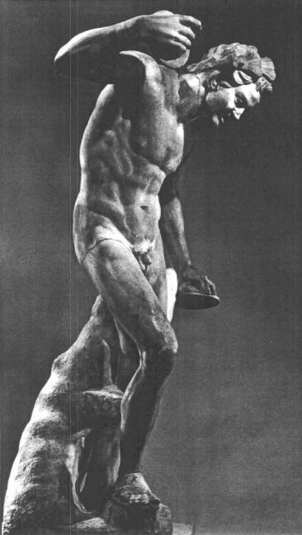
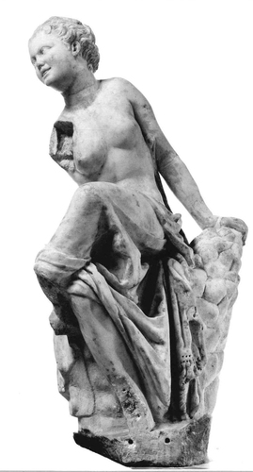
Agenda
Case study: Geneva, Musée d'Art et d'Histoire, 19026
Intertextuality and Roman ideal sculpture: Theory and method
Case study: Rome, Palazzo Corsini, 710
The Invitation to the Dance
The layout of the study
Notes:
I will begin this presentation with a case-study, an example of how the sculpture of a seated female now in Geneva can be interpreted in intertextual terms. The sculpture is depicted here to the right.
After this initial example, I will outline the theory and method of the intertextual approach, before moving on to a second case-study, this time dealing with the satyr sculpture seen here to the left, a sculpture today in the Palazzo Corsini in Rome.
The two sculptures here singled out for case-studies are traditionally ascribed to the sculpture-group “The Invitation to the Dance”, and therefore a few words regarding this reconstructed sculpture-group are, I believe, called for.
Lastly I will say something of the intertextuality-project as a whole, and of how it is to be published.

Slide 3
  Geneva, Musée d'Art et d'Histoire, 19026
Geneva
Notes:
As I envision the intertextual approach, each such study produces a reading of the form represented in one rather well-preserved Roman ideal sculpture. Our first case-study will therefore attempt a reading of the form represented by this sculpture: the seated female in Geneva.
The intertextual approach is completely formalistic: it interprets this sculpture by means of its physical form. It sets out to map all sculptures that repeat the “human forms” rendered in this sculpture. By “human forms” I mean aspects such as the figure’s pose and build, and also any garments worn by the figure.
This produces a network of formalistically related sculptures, and these are then compared, in particular with regard to whether there are variations among the “non-human” forms rendered. By “non-human” forms I mean aspects such as the sculpture’s support and items held by the depicted figure.
Variations among the “non-human” forms are seen as interesting, because they give a more multifaceted view of how the studied form could be understood within the Roman cultural context.
The sculpture’s body-type and head-type are studied separately. Let us therefore initially have a look at the body-type represented in the sculpture in Geneva.
Seen in isolation, this sculpture is rather difficult to interpret: there are no preserved attributes that clearly determine the female’s identity.

Slide 4
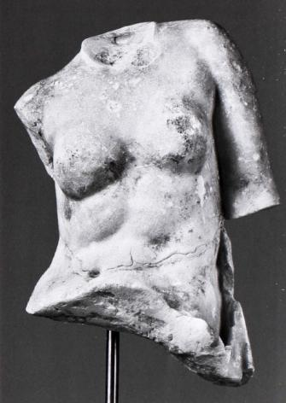
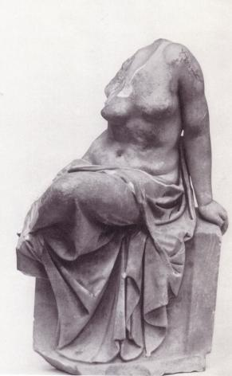
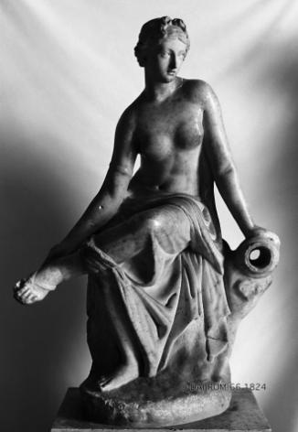
  Geneva, Musée d'Art et d'Histoire, 19026
Geneva
Dresden
Basel
Naples
Notes:
I know of 15 sculptures that repeat the “human form” of this sculpture’s body-type. Let us look at three examples.
In some instances these sculptures seem to simply repeat the traits represented by the seated female in Geneva. One such case is the torso now in Dresden. However, I am very careful not to reconstruct fragmentary sculptures. I do not assume that a fragment such as that in Dresden must have repeated the forms seen in the more well-preserved sculpture in Geneva. We simply cannot know what the full sculpture once looked like. Nevertheless, as far as preserved, the torso in Dresden repeats the body-type of the sculpture in Geneva.
In the Antikenmuseum in Basel there is a sculpture which repeats the “human form” studied, although the figure is somewhat more thick-set, and she is seated on a rectangular stool, rather than on a schematically rendered rock. This is, as far as we can tell from the preserved sculptures, the only instance where a figure with this body-type is not seated on a rock.
In three instances, the female has her left hand placed, not directly against the rock but against a vessel lying on the rock. In two cases drill-holes tell us that the sculpture could function as a fountain figure, with water spurting out from the vessel’s orifice. This is the case for the sculpture in Naples, depicted here. It should, of course, be noted that this sculpture has been restored: its head, right arm and left foot are post-antique additions.
As we all know, this particular “human form” is today rarely considered as a solitary figure. It is generally understood as having originally been part of a sculpture-group. And there are, in fact, three instances where this body-type is used as part of a sculpture-group.

Slide 5
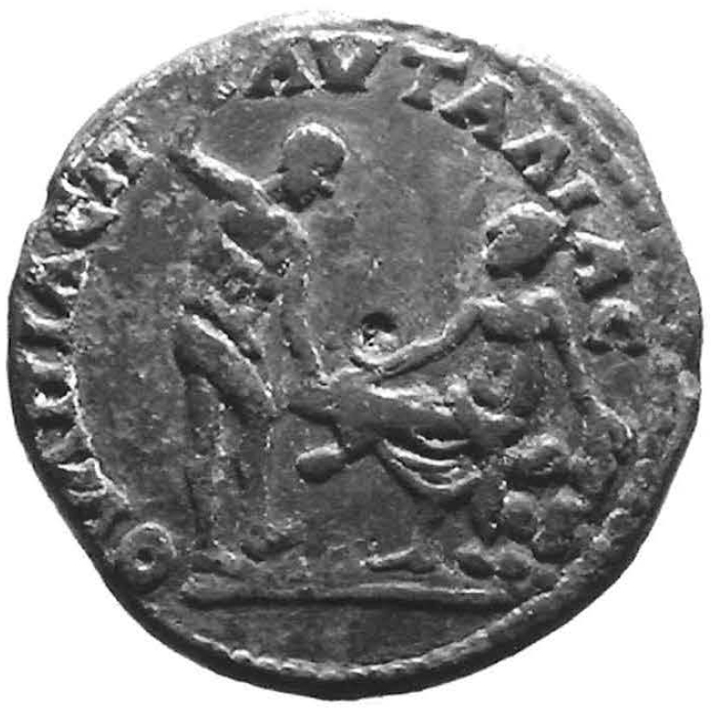
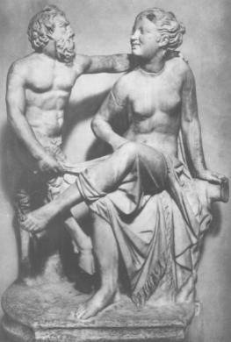
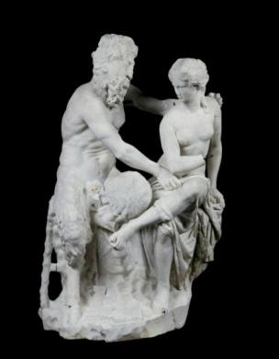
  Geneva, Musée d'Art et d'Histoire, 19026
Geneva
Pautalia
Vatican
Sotheby’s
Notes:
Here those three constellations are illustrated.
First, there are two series of coins, one minted in Kyzikos and the other, that seen here, in Pautalia in Thrace. The example seen here was published as late as 2009. Both series of coins depict a seated female next to a standing male. Since the late 19th century, both figures displayed on the coin from Kyzikos have been related to figures sculpted in the round.
In the middle, we have a sculpture-group in the repository of the Vatican, which has this female depicted with Pan. The goat-legged God stands next to the female, placing his left hand over her shoulder, while tugging at the cloth covering her lower body with his right hand.
Lastly, at the far right, we have a sculpture-group which was put up for sale at Sotheby’s New York in 2005. Allegedly with 18th century restorations, and previously in a French private collection, this piece needs to be treated with caution. As far as I know, it has never been published. The account given by Sotheby’s is unfortunately very brief. As it would seem, the theme is the same as for the sculpture-group in the Vatican, only here Pan is seated on the rock next to the female.
To sum up regarding the female’s body-type, there is evidence for a quite wide range of variation. And, as we will see, an analysis of the female’s head-type adds further facets to the picture.

Slide 6
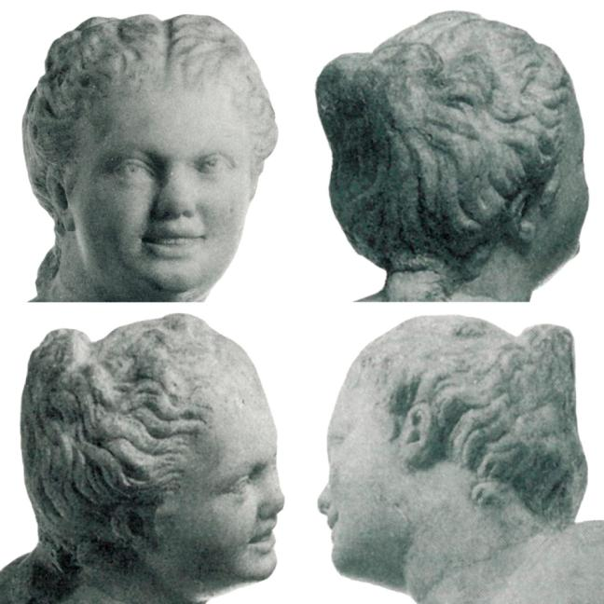
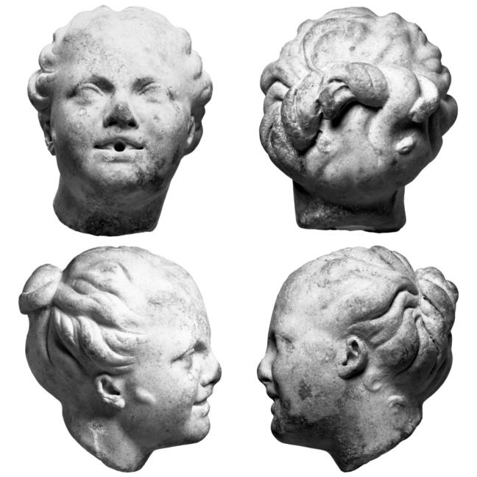
  Geneva, Musée d'Art et d'Histoire, 19026
Geneva
Baltimore
Notes:
The study of head-types requires a greater attention to detail. I know of 18 sculptures that repeat the head-type seen in the sculpture in Geneva. Here we see the female who is the focus of our attention to the left. I have added an example in Baltimore because the pair, taken together, can illustrate two points regarding the head-type studied:
Firstly, especially the sculpture in Baltimore nicely illustrates the female’s hairdo. She has parted her hair in two strands and made a simple knot high up at the back of her head.
Secondly, it is this rather peculiar hairdo that most clearly defines this head-type. The individual locks of hair framing the female’s face are not copied precisely, as is clear from the profiles of the two heads depicted here.
Among the 18 sculptures that repeat the head-type studied, there are three that include notable variations.
One of these is the head in Baltimore. This particular sculpture seems to have been used as a fountain-figure, with the water spurting out of the female’s mouth. We can see the drill-hole on the frontal photograph included here.

Slide 7
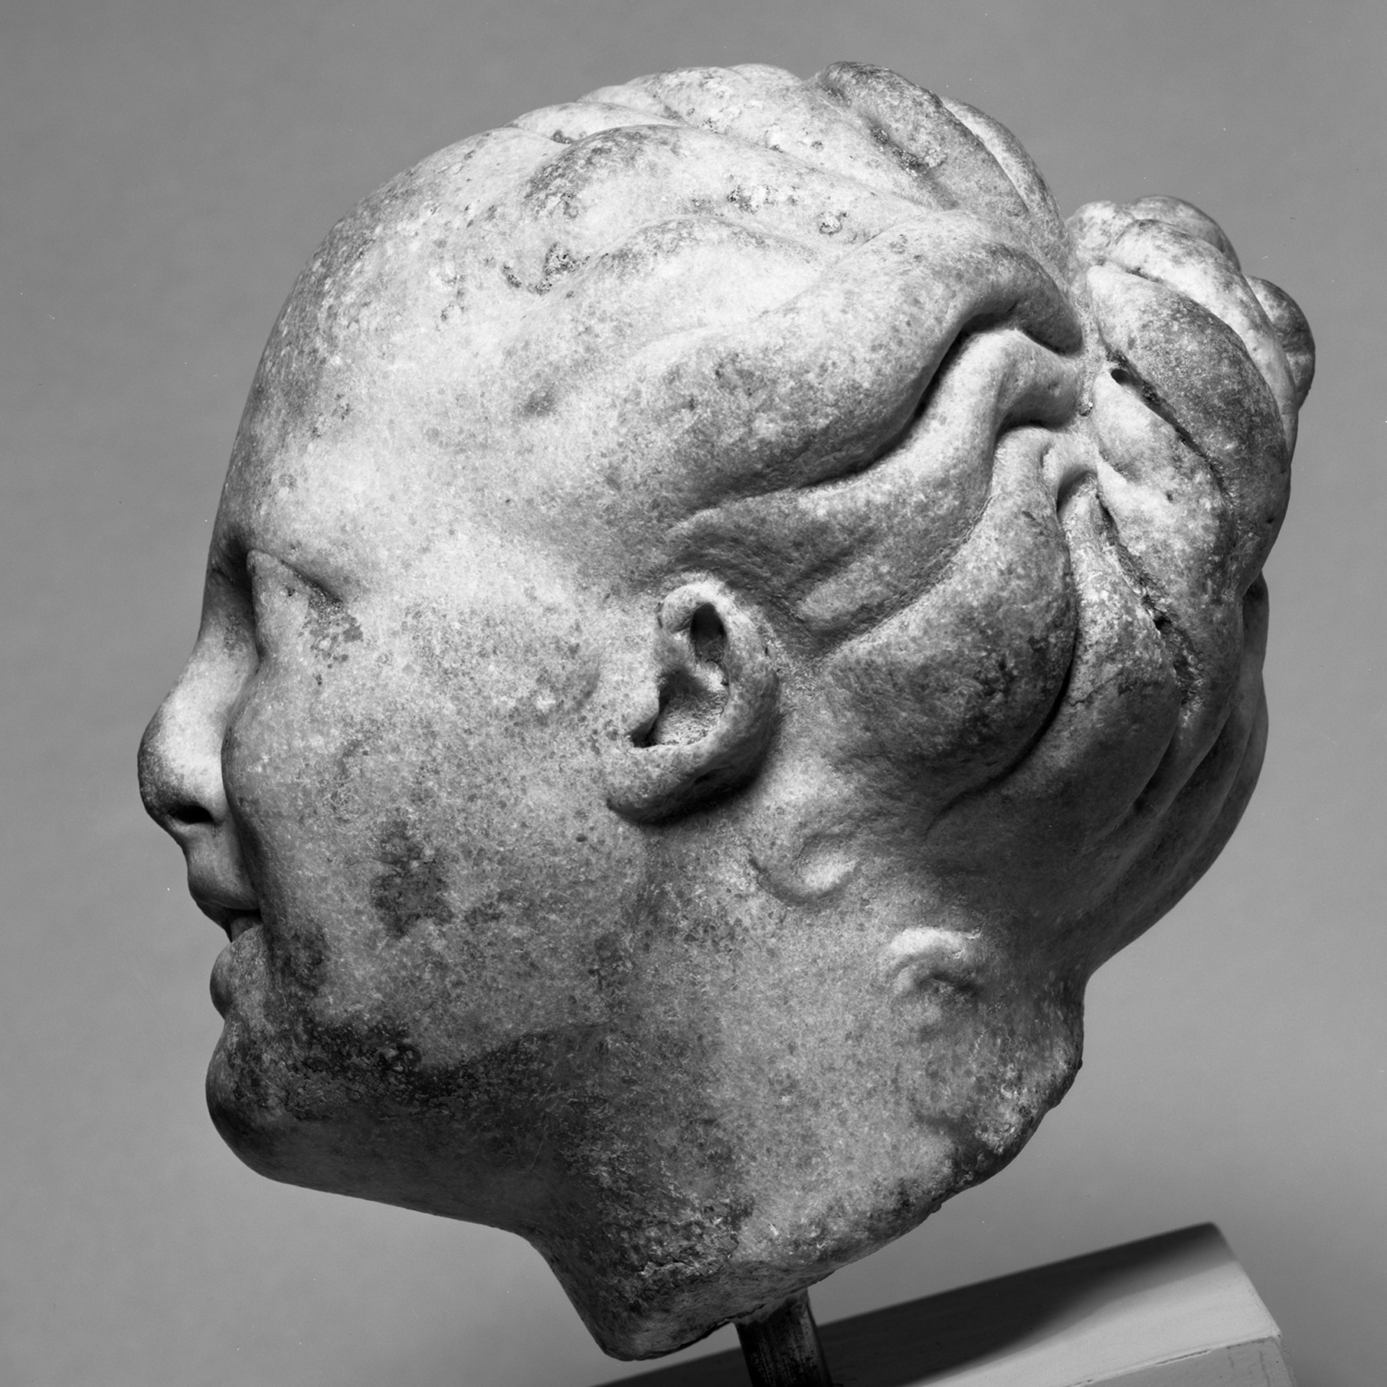
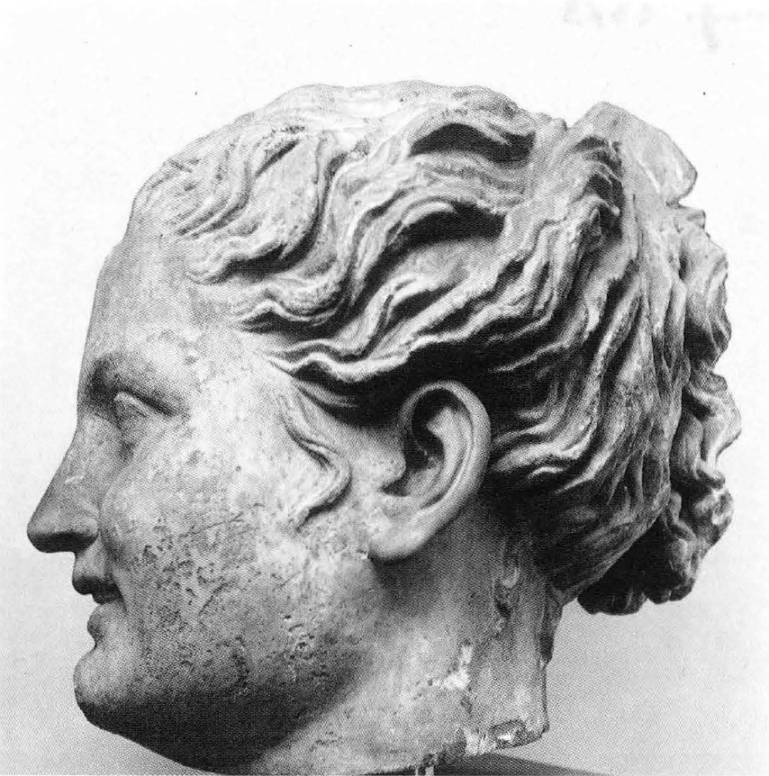
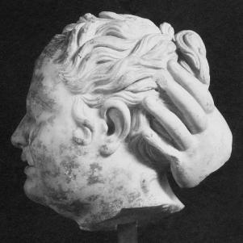
  Geneva, Musée d'Art et d'Histoire, 19026
Geneva
Baltimore
Venice
Boston
Notes:
Here all three heads that vary the theme seen in the sculpture in Geneva are illustrated.
To the far left we have the head in Baltimore again, which I will not elaborate on further.
Next is a head in Venice, which repeats the head-type on a colossal scale: the preserved fragment, comprising the female’s head, is 46 cm high. The other renderings of the type are usually slightly smaller than life-size.
The third photograph shows a head in Boston, which, apart from repeating the human traits seen in the seated female in Geneva, also preserves the hand of another figure at the back of the female’s head. What this sculpture-group originally looked like, we can only guess.

Slide 8
Notes:
This very swift presentation of the various uses of the “human form” seen in the sculpture in Geneva can be summarized in this illustration.
I would like to emphasize that the form seems to have been varied quite often. For the head-type the general hairdo, with its peculiar knot, is copied, while the rendering of individual locks of hair is varied.
Due to the wide range of variations it is tempting to suggest that this particular “human form” was, during the Roman period, used as a generic figure, albeit one tied to the Bacchic sphere.
We will return to the intertextual reading of the seated female in Geneva, but first, let us proceed to the presentation of the theoretical framework that underpins this analysis.

Slide 9
Intertextuality and Roman ideal sculpture
Theory
Method
General semiotics: Mieke Bal & Norman Bryson
There can be no such thing as one fixed, unified meaning
Intertextuality: Roland Barthes
The death of the author
Formalism
Mark D. Fullerton
‘Imitation and intertextuality in Roman art’ (JRA 10, 1997)
Reading of one well-preserved sculpture
Analysis of intertextual network
Repetition of “human forms” vs variation of “non-human forms”
Notes:
The theoretical concept of intertextuality belongs to the semiotic sphere. As you all know, semiotics has had its part to play within the study of Roman visual culture. In the newly published “Oxford Handbook of Roman Sculpture” I was pleased to read that several scholars emphasize Tonio Hölscher’s “The Language of Images in Roman Art” as a particularly influential work.
My own semiotic approach uses texts by the cultural theorist Mieke Bal and the art historian Norman Bryson as a general point of departure. Both have argued for the use of semiotic theory within art historical research.

Slide 10
Intertextuality and Roman ideal sculpture
Theory
Method
General semiotics: Mieke Bal & Norman Bryson
There can be no such thing as one fixed, unified meaning
Intertextuality: Roland Barthes
The death of the author
Formalism
Mark D. Fullerton
‘Imitation and intertextuality in Roman art’ (JRA 10, 1997)
Reading of one well-preserved sculpture
Analysis of intertextual network
Repetition of “human forms” vs variation of “non-human forms”
Notes:
It should be noted that Bal’s and Bryson’s approach to art history is markedly post-structuralist, a feature which sets it apart from the semantic approach formulated by Hölscher. Bal and Bryson emphasize the notion that there can be no such thing as ONE fixed, unified meaning.
Rather than being aggravated because years of research will not present absolute knowledge regarding Roman sculptures, this notion can actually be quite liberating. It does, for one, take the pressure off the polemic discussion regarding whether Kopienkritik is a useful approach or not. Kopienkritik is indeed quite useful, so long as one remembers that its results throw light on certain aspects of Roman ideal sculpture. But neither Kopienkritik, nor any other approach, can ever claim to discover the ONE fixed unified meaning of a sculpture, because meaning as such is not an absolute entity.
The abstract that describes this workshop poses the question: “should there be a new Kopienkritik for the 21st century?” My answer to this question is definitely “no”. If one accepts that a sculpture can never hold just ONE fixed meaning, then one must acknowledge that every sculpture deserves to be approached from several different perspectives. This, then, is why the intertextual approach is not at odds with Kopienkritik. In fact, the two approaches compliment each other very well.
The notion that there can be no ONE fixed meaning is reflected in the intertextual approach’s methodology, for instance in the sense that each study takes one, preferably well-preserved, sculpture as its point of departure. Borrowing terminology from the field of Literary studies, the intertextual approach can be said to produce readings of particular sculptures. The case-study already presented can be described as my intertextual reading of the sculpture in Geneva. In the same sense that there can be countless readings of, say, the Iliad, there can also, at least theoretically, be countless readings of this particular sculpture.

Slide 11
Intertextuality and Roman ideal sculpture
Theory
Method
General semiotics: Mieke Bal & Norman Bryson
There can be no such thing as one fixed, unified meaning
Intertextuality: Roland Barthes
The death of the author
Formalism
Mark D. Fullerton
‘Imitation and intertextuality in Roman art’ (JRA 10, 1997)
Reading of one well-preserved sculpture
Analysis of intertextual network
Repetition of “human forms” vs variation of “non-human forms”
Notes:
Let us move on, from semiotics in general, to intertextuality in particular.
The term “intertextuality” was coined by Julia Kristeva in the 1960’s. But Roland Barthes remains the most renowned theorist tied to the concept. In particular his short text “The Death of the Author” is well known. Two of the notions put forth in this article are of crucial importance to my study. We shall turn to those shortly.
First I will say something regarding intertextuality in general. Intertextual theory holds that texts, both literary and non-literary, lack any kind of independent meaning. Where a literary text is concerned, intertextual theorists argue that the act of reading plunges us into a network of textual relations. To discover meaning in a text, these relations are explored. In essence, reading is seen as a process of moving between texts, and meaning is seen to exist between one text and all other texts to which it refers and relates.
With this general characteristic of intertextuality in mind, the approach to Roman sculpture presented here is essentially the analysis of intertextual networks of formalistically related sculptures. The general idea is that a viewer interprets a sculpture by reference to what he or she has seen before. Here I turn to a second question posed in this workshop’s abstract: “Why did the accurate replication of details matter in an artistic tradition dominated by freehand carving and painting?” There were, of course, many reasons for this. But one reason is definitely tied to the legibility of the sculptures.
A Roman viewer encountering the seated female now in Geneva for the first time may have called to mind seeing the sculpture-group in the Vatican at some earlier point. Remembering that the sculpture-group depicts this female together with Pan, our viewer might instinctively conclude that also the female in Geneva should be interpreted as connected to the Bacchic sphere, even though the sculpture in Geneva does not render any Bacchic attributes.
That said, let us move on to the two concepts outlined in Barthes’ article.

Slide 12
Intertextuality and Roman ideal sculpture
Theory
Method
General semiotics: Mieke Bal & Norman Bryson
There can be no such thing as one fixed, unified meaning
Intertextuality: Roland Barthes
The death of the author
Formalism
Mark D. Fullerton
‘Imitation and intertextuality in Roman art’ (JRA 10, 1997)
Reading of one well-preserved sculpture
Analysis of intertextual network
Repetition of “human forms” vs variation of “non-human forms”
Notes:
The first is synonymous with the article’s title: “The Death of the Author”.
For Barthes, literary meaning can never be fully stabilized by the reader, because the literary work’s intertextual nature always leads readers on to new textual relations. Authors, therefore, cannot be held responsible for the multiple meanings readers can discover within literary texts. Hence, Barthes’ famous proclamation of “the death of the author”.
Transferred to sculpture, this means that the original sculptor of a particular form cannot envisage or control the multiple meanings that viewers can discover in their sculpture. This disregard for originality and authorial intention within the interpretation of meaning in art distinguishes the intertextual approach clearly from the practice of Kopienkritik. It does, however, not mean that the two approaches are incompatible.

Slide 13
Intertextuality and Roman ideal sculpture
Theory
General semiotics: Mieke Bal & Norman Bryson
There can be no such thing as one fixed, unified meaning
Intertextuality: Roland Barthes
The death of the author
Formalism
Mark D. Fullerton
‘Imitation and intertextuality in Roman art’ (JRA 10, 1997)
Notes:
The consequences of the notion of “the death of the author” can be illustrated in two figures, one of these is seen here to the right.
In the center of this figure we have the sculpture-group in the Vatican. This sculpture could be brought forth as an example of the eclecticism of Roman sculpture, an aspect that has received much attention in recent years. When confronted with such a sculpture, scholars usually point out the earlier sculptural compositions which the eclectic piece refers to by means of its form. For this piece, scholars have pointed out that the sculpture combines the female from the so-called “Invitation to the Dance” (seen here at the top) with a figure of Pan, who repeats this deity’s head-type as otherwise depicted in the so-called “Pan and Daphnis-Group” (seen here at the bottom of the figure).
Chronology has a crucial part to play in this line of reasoning, where the presumably later eclectic constellation is interpreted by reference to sculptural compositions believed to have been made earlier. This relationship is, however, rarely allowed to work both ways. That is to say that the later eclectic composition is not seen to have any significance for the interpretation of the earlier compositions.
Intertextual theory, by contrast, emphasizes that these relationships can, indeed, work both ways. Hence, the only thing that changes as we move on to the second figure are the arrows, which now point both ways.

Slide 14
Intertextuality and Roman ideal sculpture
Theory
General semiotics: Mieke Bal & Norman Bryson
There can be no such thing as one fixed, unified meaning
Intertextuality: Roland Barthes
The death of the author
Formalism
Mark D. Fullerton
‘Imitation and intertextuality in Roman art’ (JRA 10, 1997)
Notes:
In essence then, once an eclectic composition has been made, its existence has the potential to change how the earlier forms are interpreted by a viewer. The original sculptor responsible for the so-called “Invitation to the Dance” could not have foreseen that this form was to be used in the eclectic manner seen in the sculpture in the Vatican. Hence, the original sculptor’s intentions can never present us with a full account of the meaning that his or her sculpture could convey.
This brings us to another aspect of the intertextual approach, as I practice it in this study: it is completely synchronic. It interprets the preserved ideal sculptures as an expression of Roman visual culture in general.

Slide 15
Intertextuality and Roman ideal sculpture
Theory
Method
General semiotics: Mieke Bal & Norman Bryson
There can be no such thing as one fixed, unified meaning
Intertextuality: Roland Barthes
The death of the author
Formalism
Mark D. Fullerton
‘Imitation and intertextuality in Roman art’ (JRA 10, 1997)
Reading of one well-preserved sculpture
Analysis of intertextual network
Repetition of “human forms” vs variation of “non-human forms”
Notes:
Continuing with the second notion listed here in connection with Roland Barthes’ name, we come to the concept of “formalism”.
The intertextual approach to Roman ideal sculpture, as I have formulated it, is completely formalistic. In his article, “The Death of the Author”, Barthes not only separates the text from authorial intention, he also separates it from reference to the real world beyond itself. What might appear to be realism is only the repetition, within the text, of the discursive forms which, in Barthes’ view construct reality.
With this notion in mind, I will allow the intertextual approach to Roman ideal sculpture to be completely formalistic. It derives its reading of the studied sculptures exclusively from their physical form. This has the great advantage of making the approach applicable to all sculptures that render a repeated form, regardless of whether the sculptures’ original contexts are known or not.
Even though Kopienkritik was not initially formulated as a mainly formalistic approach, it has often come to be used as such. The fact that Kopienkritik is applicable to sculptures with no known provenance is, I believe, one of the reasons why the approach has become so frequently used. It is, however, not the only formalistic approach possible. In formulating an intertextual approach, I wish to add a formalistic alternative, an approach that highlights completely different aspects of Roman ideal sculpture.

Slide 16
Intertextuality and Roman ideal sculpture
Theory
Method
General semiotics: Mieke Bal & Norman Bryson
There can be no such thing as one fixed, unified meaning
Intertextuality: Roland Barthes
The death of the author
Formalism
Mark D. Fullerton
‘Imitation and intertextuality in Roman art’ (JRA 10, 1997)
Reading of one well-preserved sculpture
Analysis of intertextual network
Repetition of “human forms” vs variation of “non-human forms”
Notes:
It has often been noted that Roman sculptors seem to have copied human bodies quite precisely, while taking the liberty to vary other aspects in the compositions rendered, such as the support. This is why my intertextual approach traces repetition of what I here call the “human form” of the sculpture under scrutiny. This limits the number of sculptures studied, it defines the range of the intertextual network of sculptures taken into consideration.
For the interpretation of the studied intertextual network of sculptures, variations among the “non-human” forms are seen as particularly interesting. This is because such variations have the potential to present us with a more multifaceted view of how the studied form was perceived. For instance, various different attributes may be included, or, as is the case for the sculpture in Geneva, the studied form may be included in groups together with other figure-types.

Slide 17
Intertextuality and Roman ideal sculpture
Theory
Method
General semiotics: Mieke Bal & Norman Bryson
There can be no such thing as one fixed, unified meaning
Intertextuality: Roland Barthes
The death of the author
Formalism
Mark D. Fullerton
‘Imitation and intertextuality in Roman art’ (JRA 10, 1997)
Reading of one well-preserved sculpture
Analysis of intertextual network
Repetition of “human forms” vs variation of “non-human forms”
Notes:
Last but not least, I want to emphasize that professor Mark Fullerton suggested that the study of Roman ideal sculpture might benefit from theories of intertextuality already in 1997. His review-article in the Journal of Roman Archaeology caused the term “Intertextuality” to echo faintly within the continuing discussion regarding repetition in ancient art. But as far as I know no coherent study using an intertextual approach has been published.
Professor Fullerton’s article of 1997 served as the initial inspiration for this project and I am very happy that he has encouraged me to explore his idea further.
Now, let us turn to our second case-study, keeping these theoretical considerations in mind.

Slide 18
Rome, Palazzo Corsini, 710
Rome
Notes:
This time I will attempt an intertextual reading of the satyr-sculpture, kept in the Palazzo Corsini in Rome. The sculpture is rather well preserved, although the hands with the cymbals are restored, as are parts of the legs. The head has been reattached.
Also this time, we will begin with the sculpture’s body-type. As far as I know, there are 15 sculptures that repeat the body-type seen in the satyr in Rome. In other words, the body-type can be linked to an intertextual network comprising 15 sculptures. Interestingly enough, there are not many that include variations among the composition’s “non-human” forms.
When preserved, the support is always shaped as a tree-trunk, although these tree-trunks are never rendered in exactly the same way. At times there are also different Bacchic attributes placed on the support, be it a set of pan-pipes, a shepherd’s staff, or the skin of a goat.

Slide 19
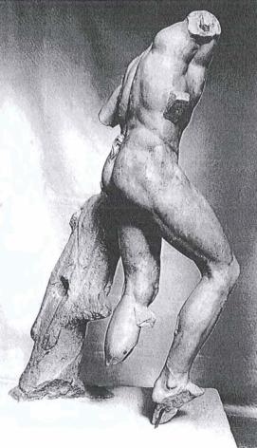
Rome, Palazzo Corsini, 710
Rome
Athens
Pautalia
Notes:
There is a sculpture in Athens, seen here in the middle, which includes both a set of pan-pipes and a shepherd’s staff. What should be noted in particular for this sculpture, though, is that drill-holes through the support show that it could have functioned as a fountain-figure, with the water spurting out of the mouth of the goat-skin draped over the support.
As for the support, also the rendering of the foot-clapper varies slightly among the preserved examples.
Then there are, of course, the coins from Pautalia and Kyzikos, which seem to display a sculpture repeating this body-type, placed next to a female, similar to that in Geneva.
Apart from this, there are no clear variations among the renderings of this particular body-type.

Slide 20
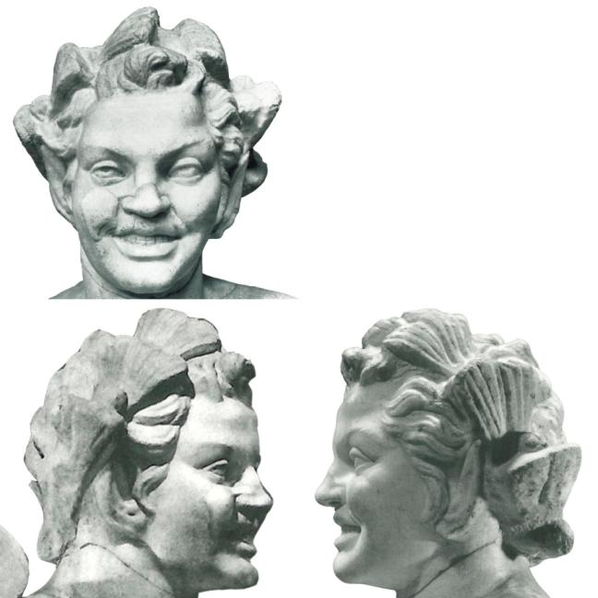
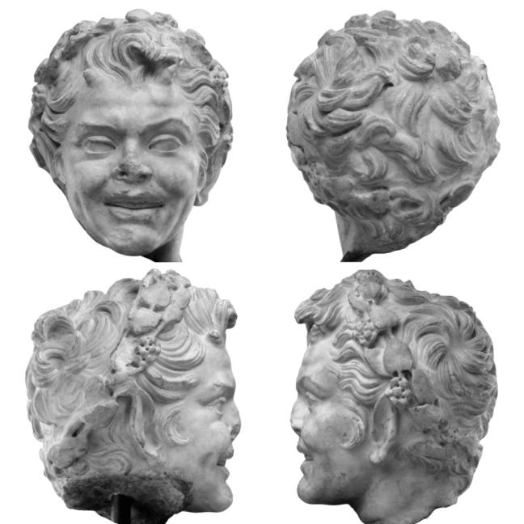
Rome, Palazzo Corsini, 710
Rome
Princeton
Notes:
Turning to the sculpture’s head-type, I have again included a second sculpture for comparison.
The sculpture in Rome displays a quite distinct rendering of the hair, which is repeated between reproductions of the type. Take, for instance, the lock above the satyr’s forehead, which is raised upwards and then falls down, somewhat to the left. One can also point to the way the locks of hair run away from the face above the satyr’s right ear in bent, yet parallel strands. On the contrary, on the satyr’s left side the locks come together in a point above the satyr’s left ear.
The head-type represented in the sculpture in Rome is repeated in at least 13 sculptures. It is notable that all the sculptures within this intertextual network replicate the satyr’s hair quite faithfully.
But, as we can see in these two examples, the satyr is not always rendered wearing a wreath made of pine-twigs. The head in Princeton sports a wreath made of ivy. Most commonly, however, the satyr does not wear a wreath at all.

Slide 21
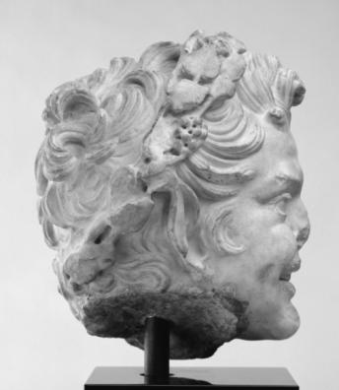
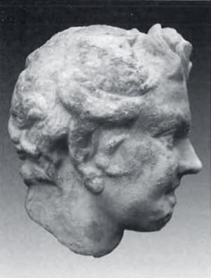
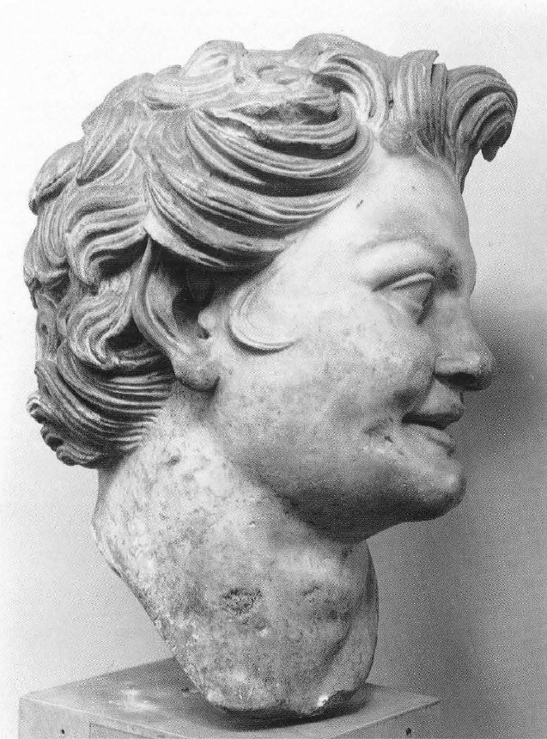
Rome, Palazzo Corsini, 710
Rome
Princeton
Barnstable
Venice
Notes:
Here we have the satyrs in Rome and Princeton depicted again.
Then, in the middle, there is a satyr-head now in a private collection in Barnstable, MA. This is one of the examples where the satyr does not appear to be wearing a wreath. But the head in Barnstable is interesting in that it shows a drill-hole at the back of the satyr’s neck, which may perhaps have been used to fasten a wreath made of a different material.
Lastly, there is one example where the satyr has been rendered on a colossal scale, which is the case for the head in Venice, depicted here to the far right. The height of this fragment is 67 cm, thus clearly larger than life-size. Other repetitions of the this human form are rendered in slightly less than life-size.

Slide 22
Notes:
All in all, this intertextual reading presents a strikingly coherent picture. The sculptures that repeat the “human form” seen in the satyr in Rome do not include a very wide range of variations. Taken as a group, the sculptures that repeat these “human forms” are very consistent in formalistic terms.

Slide 23
The Invitation to the Dance
Notes:
What, then, of the renowned sculpture-group called “The Invitation to the Dance”?
The question of whether “The Invitation to the Dance” was the original manifestation of these two sculpture types is simply not of relevance within the frames of the intertextual approach. But given the significance that the reconstructed group has had within previous research, a few thoughts on the relationship between the two types are called for.
There definitely is a connection between the two “human forms”. There are, of course, the two coin-images, both minted during the reign of Septimius Severus, around AD 200.
Another connection between the two is that for each only one rendering on a colossal scale is known, and these both belong to the same collection: the Archaeological Museum in Venice. Unfortunately, their original context is unknown.

Slide 24
The Invitation to the Dance
Notes:
Judging from the intertextual analysis of the sculptures in Geneva and Rome, the two “human forms” seem to have been used in distinctly different ways during the Roman era:
As we have seen, there are many variations attested for the female. I would even suggest that this “human form” was, at least within the Roman context, something of a generic figure, which was varied almost at will. Minor details, such as the rendering of individual locks of hair, were also varied. Furthermore, as solitary figures, the sculptures that repeat this “human form” are generally quite ambiguous: apart from the occasional inclusion of a water-vessel, there are (as far as we can tell) no clear attributes that determine the female’s identity.
The satyr, on the other hand, is not varied as freely. There is a much greater coherence in the rendering of this “human form”, even comprising the manner in which individual locks of hair were fashioned. This might suggest that a stricter coherence to an original form was upheld for the satyr. With his pointed ears, horns and tail, there can be no doubt regarding the figure’s identity: he is a satyr. But even so, additional Bacchic attributes were often included when this “human form” was repeated. There is no ambiguity what so ever in the interpretation of this “human form”.
Regardless of the connection between these two types, it should be emphasized that they do seem to have been replicated in completely different ways during the Roman era. With that said, let us return to “The Invitation to the Dance”. The nature of the interaction between these two figure-types has long been a matter of discussion.

Slide 25
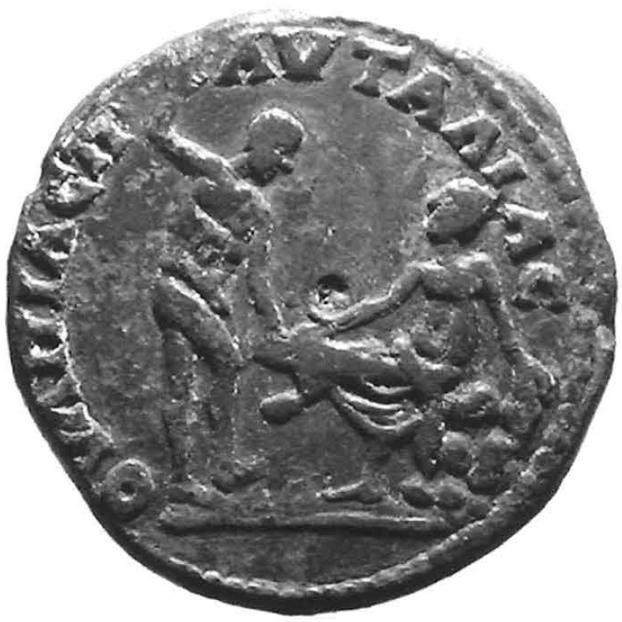
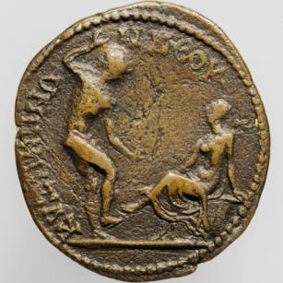
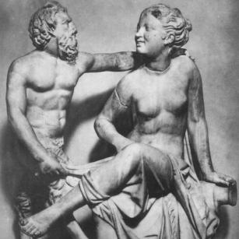
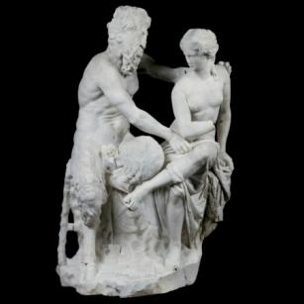
The Invitation to the Dance
Notes:
The traditional view, first formulated by Wilhelm Klein in 1909, is that the satyr is snapping his fingers and playing a foot-clapper as a gesture to invite the seated nymph to the dance. To the left we have a reconstruction made to match this interpretation.
Some have, however, noted that satyrs are generally no gentlemen, and that this scenario would be quite uncharacteristic of a sculpture-group combining a Bacchic male and a female.
If one looks at the wider intertextual network tied to the female figure, it can be concluded that when this “human form” is included in groups, such as that in the Vatican, and – with reservations – that at Sotheby’s, the seated female is approached by a Bacchic male who tugs at the cloth covering her lower body. I would say that this is the scene also rendered on the coins from Pautalia, here the coin depicted in black and white. Hence, I would suggest that if these two types were combined in a sculpture-group, the interaction between the two would have been more hands-on than usually assumed.
In previous research on “The Invitation to the Dance” the sculpture-group in the Vatican is generally dismissed as a Roman pastiche which is of no relevance to the interpretation of the sculpture-types in general. This is, of course, a consequence of Kopienkritik’s focus on reconstructing original masterpieces. I hope that the intertextual approach could be an alternative characterized by its insistence on attributing equal importance due to all repetitions of the human form studied. I am convinced that such an approach has the potential to further our understanding of Roman visual culture significantly.

Slide 26
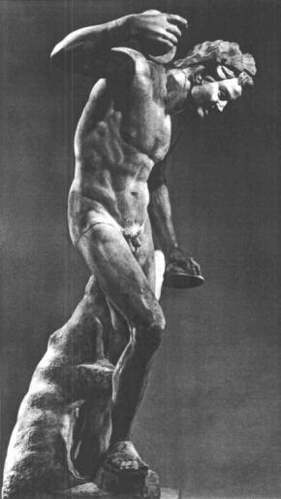
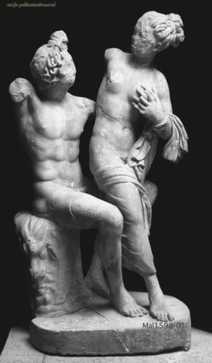
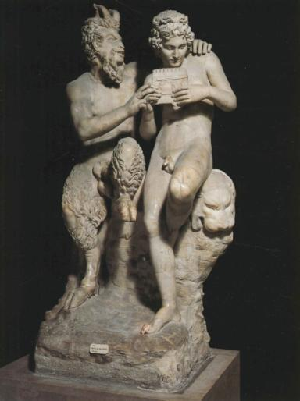
The layout of the study
Notes:
To conclude, I will briefly summarize the layout of my intertextuality-project as a whole. I hope to publish this research in a monograph.
There is some inconsistency between the case-studies presented here and the theoretical concept of intertextuality. Also the sculptures, in relation to which the female and the satyr have here been interpreted, are intertextual. Each sculpture is tied to an endlessly expanding network of formalistic relations, and all such relations can potentially have a bearing on how the forms could be interpreted.
I have tried to acknowledge this ever expanding network of related forms in the layout of the study as a whole. Here we see the seated female in Geneva, and the satyr in Rome. Next to them we have two sculpture-groups which will also be analyzed in my monograph. The book will include one chapter devoted to each of these sculptures, performing an analysis such as that outlined above for the seated female and the satyr.
The crucial point here is that all of the sculptures singled out for case studies are formalistically interrelated.

Slide 27
The layout of the study
Notes:
The two sculptures that have been presented here are, as we have seen, linked through the coin-images from Pautalia and Kyzikos, and possibly also through the two colossal heads now in Venice.

Slide 28
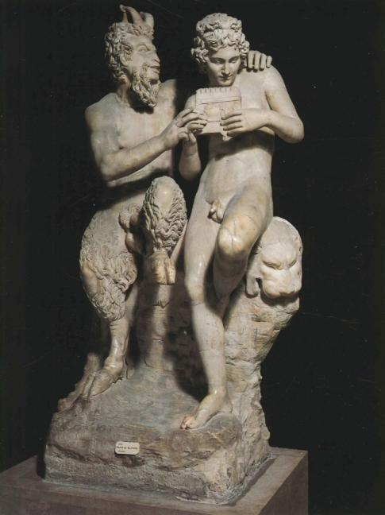

The layout of the study
Notes:
The third case-study deals with the sculpture-group believed to represent Pan and Daphnis. Here we can recognize Pan’s head-type from the sculpture-group in the Vatican, including our seated female and a standing Pan.

Slide 29

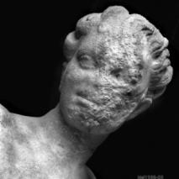
The layout of the study
Notes:
Lastly there is the so-called “Ludovisi symplegma”, seen here on the right-hand side, which includes a female figure who’s facial features are the same as those of our seated female. Only details of the hairdo separate these two head-types. This sculpture-group renders a seated satyr and a standing female.

Slide 30
Thank you!
Notes:
In this manner, then, the four case-studies that make up the complete monograph do at least hint at intertextuality’s endless network of interrelated sculptural forms.
What I wish to emphasize is that the accurate repetition of forms in Roman ideal sculpture was not only due to the well-attested fascination for Greek and Hellenistic masterpieces. Repeated forms were also used as visual signifiers which facilitated the interpretation of sculptures.
Taking the extended intertextual network depicted here as an example, I would say that it is no coincidence that the theme is always a Bacchic one. Seen in isolation, the sculpture at the network’s centre, the seated female in Geneva, may seem ambiguous, with its lack of clear attributes. But the “human form” that it represents was clearly tied to the Wine-Gods entourage.
And with that said, we have reached the end of this paper.
[Animation]
I thank you all for your kind attention!

